Slide 1
Changing States

Slide 2

By the end of this lesson, you should be able to:
Describe, in terms of particles, the properties of the three main states of matter.
Identify how heating and cooling can change the state of a substance.
Evaluate how water responds to temperature changes.

Slide 3

Everything is made of matter and matter is made of particles!
Matter is any substance that has mass and takes up space.
That means that you’re made of particles, the computer you’re doing this lesson on is made of particles, even your breakfast is made of particles!
How matter looks and behaves has to do with the particles it’s made of. This means that if a substance changes state, it’s due to the particles that it’s made of changing their behaviour.

Slide 4
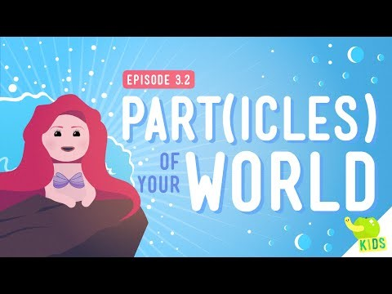

Slide 5
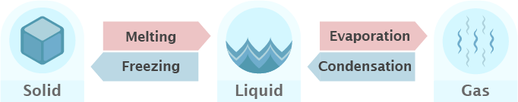
Substances can change from one physical state to another.
This process is called a state change. In order for a state change to occur, the particles in the substance need to gain or lose heat energy.
For a particular substance, its solid state has the lowest energy, followed by the liquid state, while its gaseous state has the highest energy.

Slide 6
Changing the temperature of a substance either adds or removes energy from that substance.
Heating a substance adds energy to its particles.
Cooling a substance removes energy from its particles.
Changing a substance's temperature changes the behaviour and arrangement of its particles. This changes the state of matter the substance is in!

Slide 7
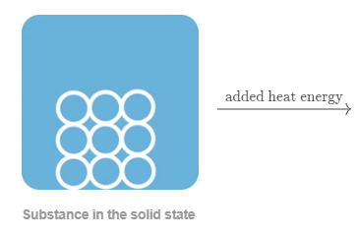

Solids are the lowest energy state of matter.
When a substance in the solid state gains heat energy, its particles also gain energy and begin to vibrate faster.
Initially, the average energy of the particles increases, and therefore the temperature of the substance increases.
Substance in the solid state at higher temperature

Slide 8
When the particles in a solid gain enough energy, the bonds holding the particles together can be broken.
As the bonds between particles are broken, the substance begins to turn from a solid into a liquid.
The phase change from a solid to a liquid is called melting.
While the state change is occurring, the temperature of the substance does not increase. This is because the added heat energy is being used to break the bonds between the particles, rather than increasing the energy of the particles.

Slide 9


Liquids are higher in energy than solids.
When a substance in the liquid state is heated, heat energy is transferred to its particles, making the particles move around faster.
The average energy of the particles increases, so the temperature will again increase.
Substance in the liquid state
Substance in the liquid state at higher temperature

Slide 10
When the particles in the liquid gain enough energy, the bonds between the particles begin to completely break, and the substance begins to turn from a liquid into a gas.
The state change from a liquid to a gas is called evaporation, or boiling.
While this state change is occurring, the temperature of the substance does not increase. The added heat energy is being used to break the bonds between the particles, rather than increasing the energy of the particles.
Substance in the liquid state
Substance in the gas state

Slide 11
Gases are the highest energy state of matter.
When a substance in the gaseous state is cooled, energy is removed from its particles. The energy of the particles decreases, which makes the particles move around less.
Initially, the temperature of the substance decreases, because the average energy of the particles decreases.

Slide 12
As the particles in a gas lose energy, they move slower, and come closer together.
They are no longer moving fast enough for the bonds to be overcome, and bonds begin to form between the particles. The substance begins to turn from a gas into a liquid.
The phase change from a gas to a liquid is called condensation.
During the phase change from gas to liquid, the heat energy that is removed comes from the formation of bonds between the particles. The energy of the particles is not decreasing, so the temperature of the substance does not decrease.

Slide 13
Liquids are lower in energy than gases.
When a substance in the liquid state is cooled, energy is removed from its particles. This decreases the energy of the particles, and the particles move around less.
The temperature again decreases, because the average energy of the particles decreases.

Slide 14

As the particles in the liquid lose energy and move around slower, they no longer have enough energy to overcome the bonds between them.
These bonds are no longer being constantly formed and broken, and the particles settle into a stable arrangement. They are unable to freely move around, and the substance begins to turn from a liquid into a solid.
The phase change from a liquid to a solid is called freezing.
Both liquid and solid states will be present in the substance during freezing. Once freezing is complete, the whole substance will be in the solid state.
Substance in the liquid state
Substance in the solid state

